Slide 1
She:kon!
Boozhoo!
Tansii!
Kwe Kwe!
Aaniin!
Greetings!
Programme Overview

Slide 2
Mission
Turtle Island Conservation partners with First Nations communities to preserve cultural & natural landscapes.

Slide 3
Vision
Preservation of First Nation Ways of Knowing will be utilized to preserve Traditional Knowledge to guide communities for generations to come.

Slide 4
Putting history into context…
First Nation knowledge and teachings of oral history are passed from generation to generation and describe changes since the beginning of time.
Tethered in ancient experience and accumulated over great periods of time, these teachings extend to the present and are shaped to meet changing landscapes.
Human history in Canada began about 12,000 years ago as glaciers began retreating. Traditional Knowledge has been passed down for over 500 generations and extends back to the beginning of time.
Oral teachings speak of ancestral traditions that will shape and guide people yet to come.

Slide 5
Turtle Island Conservation’s 5 programme objectives

Slide 6
1. Foster respect for self, community, Mother Earth, and the Creator
Link First Nation community, youth, Knowledge keepers and Elders
Preserve and respect Traditional Knowledge and ceremony
Assist in establishing cultural mapping as repositories for community knowledge

Slide 7
2. Recognize and record significant landscapes valued by FN communities
Values landscapes, teachings, and community history to preserve Traditional Knowledge
The Ways of Knowing Guide Earth’s Teachings facilitates sharing of community knowledge
Creating a Sacred Spaces & Special Places “map” (visual layered narrative) is a guide to valued community landscapes

Slide 8
Provide opportunities for youth value the sciences and develop culturally relevant school resources
Focus on biodiversity, and the importance of water and watersheds, for healthy communities and wildlife
Encourage independent economic sustainability (ie. cultural centers, knowledge trails, medicine walks)
Use Traditional Knowledge as a guide for communities for generations to come
3. Integrate Traditional Ways of Knowing with Western Science to monitor, protect and restore cultural and natural landscapes

Slide 9
4. Integrate language, art & crafts to sustain Traditional Ways of Knowing and living
For example:
Turtle Island Creation story
13 Moons lunar guide to seasonal practices
Thanksgiving address
Wampum Belt teachings
Seven Generations as basis for Youth/Elder dialogue
Traditional Knowledge trails
Share Knowledge, language & resources.

Slide 10
5. Facilitate understanding of diversity of FN culture and Ways of Knowing among non-Aboriginals
Use Toronto Zoo to deliver First Nations message as a “meeting place”
TIC outreach to schools/communities
Develop culturally appropriate learning opportunities
National Aboriginal Day celebrations
Forum for Aboriginal and non-Aboriginal youth to share knowledge
Leadership programmes/Professional development training
First Nation Art Garden & Creation Stories

Slide 11
First Nation Outreach to Schools & Communities
* Turtle Island Conservation Team’s Totally Awesome Turtles presentation
* Sacred Spaces & Special places Mapping helps to establish dialogue between youth and Elders
* Curriculum-based Educational bundle
Contributes to awareness, value and understanding of Traditional Knowledge

Slide 12
Promoting Environmental Studies in First Nation Communities
Wetland conservation
Cultural Mapping of Sacred Spaces & Special Places
Surveying & biodiversity monitoring
Turtle & Frog Conservation
Turtle Tally Program
FROGWATCH Program

Slide 13
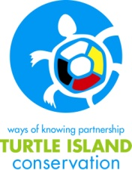
Programme Resources Available
We explore the relevance of Traditional Knowledge with regards to teachings about living sustainably with our environment and the importance of connecting with the land (and its inhabitants) on spiritual, emotional, physical, and mental levels in order to guide our practices and actions.
The educational resources we produce preserve knowledge inherent in language based resources to promote Stewardship and Conservation of biodiversity.

Slide 14
Resources
The Ways of Knowing Guide Earth’s Teachings
Creating an understanding of Indigenous worldviews
This guide is a journey into traditional knowledge reflected through worldviews, values, beliefs and stories that speak to the fundamental principles of ensuring sustainable relationships with the land.

Slide 15
Resources
Walking with Miskwaadesi
You are invited to walk in the footsteps of Miskwaadesi to learn about environmental issues that confront plant and animal members of the water world.
*Focused on Anishinaabe First Nation Traditional knowledge & Western Science ways of knowing.

Slide 16
Resource
Walking with A'nó:wara
You are invited to walk in the footsteps of A'nó:wara to learn about environmental issues that confront plant and animal member of the water world
*Story focused on Haudenosaunee Traditional Knowledge and Western Science ways of knowing

Slide 17
Resource
Based on Ontario Provincial Education Ministry’s Expectation guidelines
All photo-copy ready activity work sheets and web links are provided inside guide
Ontario Curriculum- based Activities guide focused on grades 4-6
Companion document for Walking with Miskwaadesi and Walking with A'nó:wara

Slide 18
Frog Calls CD
Resources
Ojibway
Curriculum Education bundle component
Mohawk

Slide 19
Identifier Guides
Resources
Available in Haudenosaunee and Anishinaabe languages
Ontario Species at Risk laminated identifiers for turtles, frogs, toads, salamanders & snakes
Ojibway
Mohawk

Slide 20
Turtle Crossing signs
Resources
Mohawk
Ojibway

Slide 21
RESOURCES 13 Moons Calendar
Traditional teaching tool for First Nation Schools

Slide 22
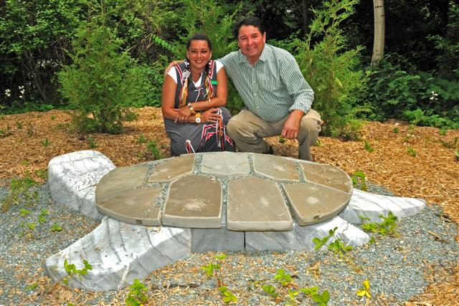
Visit our First Nation Art Garden at the Toronto Zoo located next to the America’s Pavillion
Traditional Knowledge imbedded visual narratives

Slide 23
Chi Miigwetch, Nya:wen Kowa
On behalf of The Toronto Zoo, Turtle Island Conservation and our generous funders. We thank you for sharing in our vision.
Please feel free to contact us at turtleisland@torontozoo.ca
Visit our website
www.turtleislandconservation.com

